Slide 1
GENETIC ALGORITHMS
Course Code: CSC4226
Course Title: Artificial Intelligence and Expert System
Dept. of Computer Science
Faculty of Science and Technology
Lecture No: | Five (5) | Week No: | Five (5) | Semester:
Lecturer: | Dr. Muhammad Firoz Mridha, Associate Professor, Dept of CS Email: firoz.mridha@aiub.edu

Slide 2
Lecture Outline
What are GA’s ?
Biological Background.
Basic Genetic Algorithm.
Encoding.
Operators of GA.
Example Problem.

Slide 3
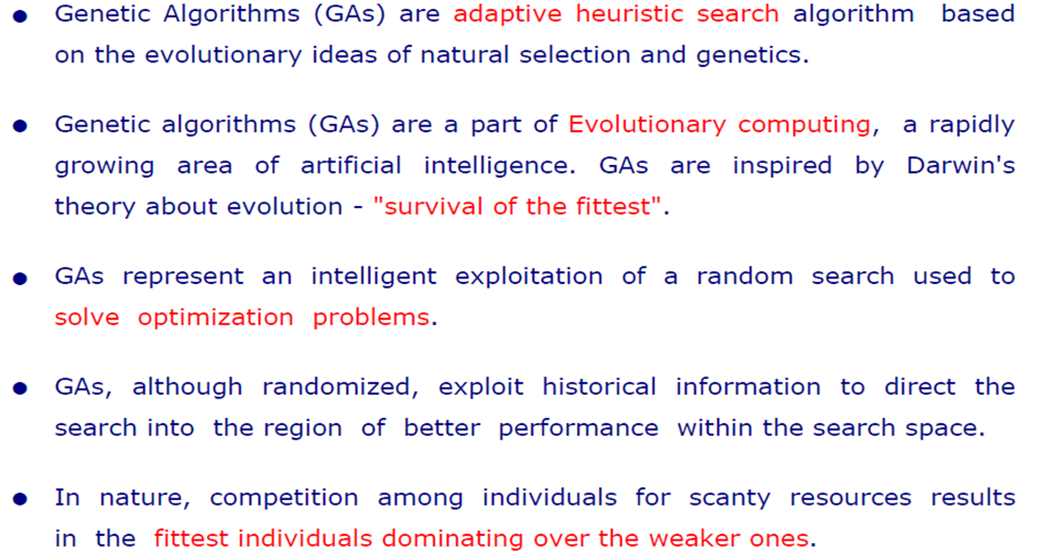
What are GAs?

Slide 4
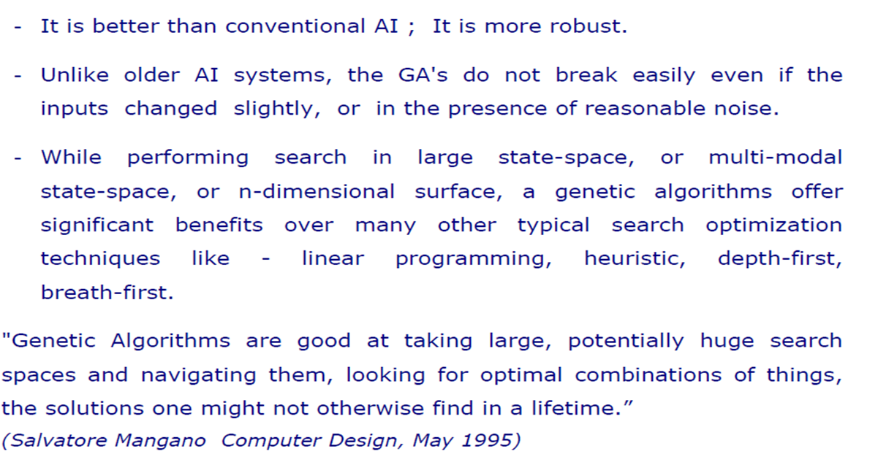
WHY GA?

Slide 5
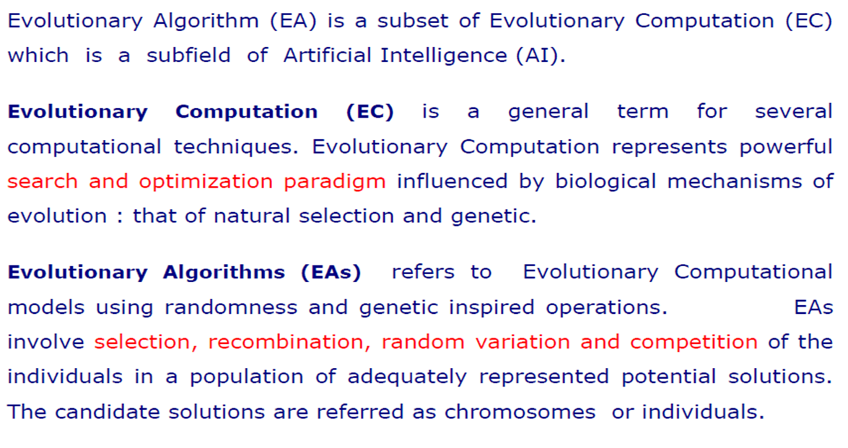
EVOLUTIONARY ALGORITHMS

Slide 6
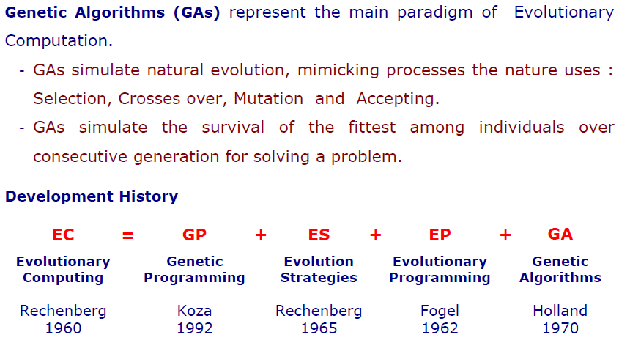
Topic Heading..

Slide 7
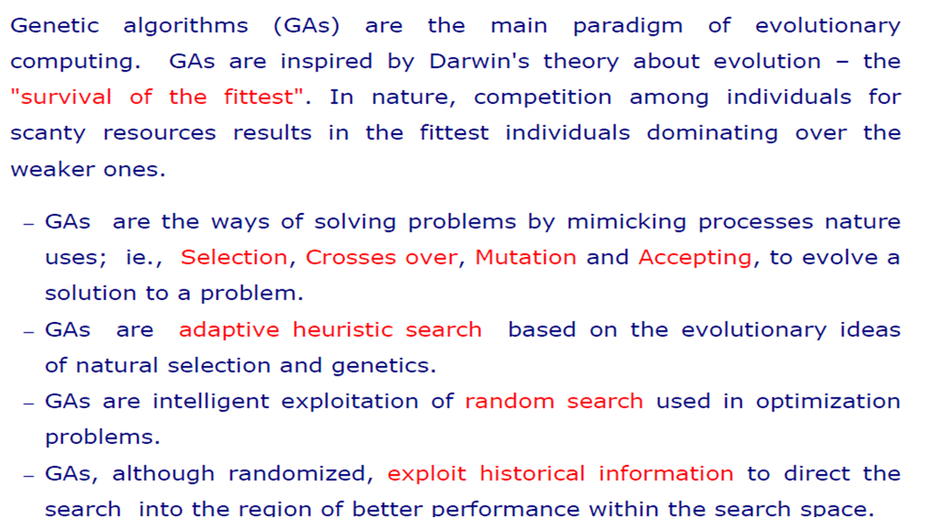
GA: BASIC CONCEPT

Slide 8
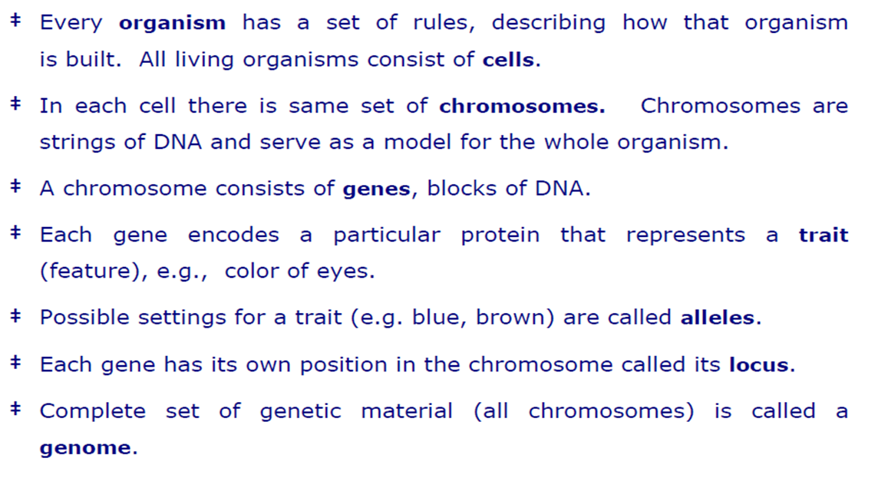
BIOLOGICAL BACKGROUND

Slide 9
BIOLOGICAL BACKGROUND

Slide 10
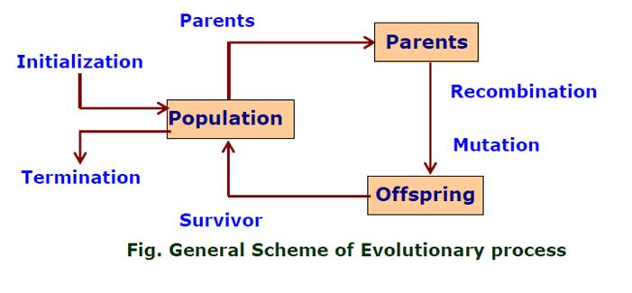
GA: FLOW-CHART

Slide 11
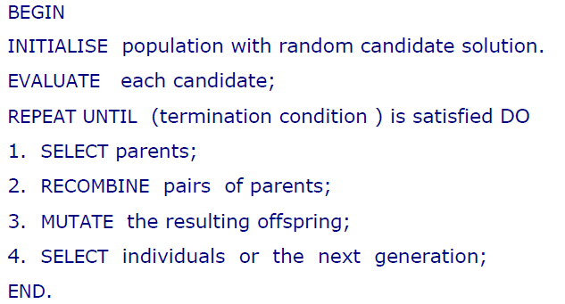
GA: PSEUDO-CODE

Slide 12
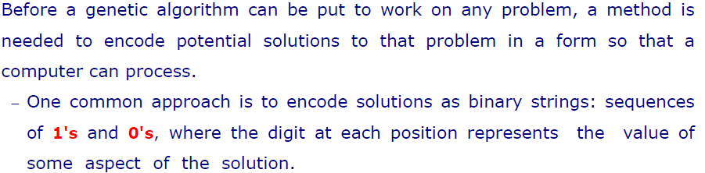
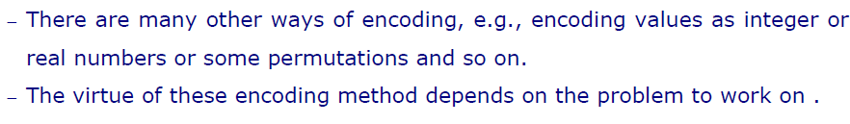
ENCODING

Slide 13
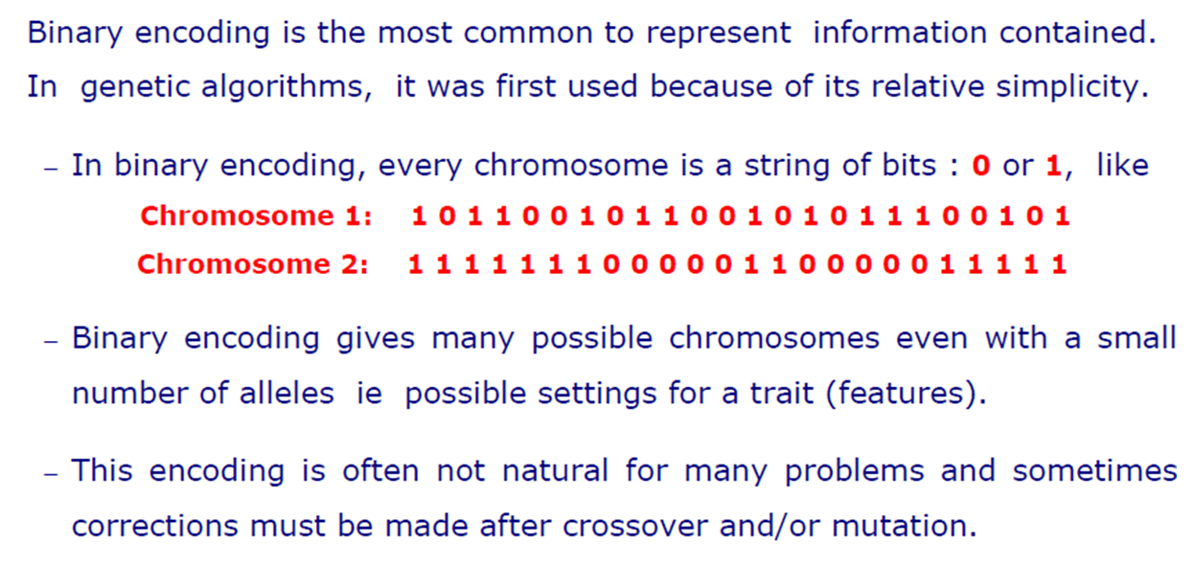
BINARY ENCODING

Slide 14
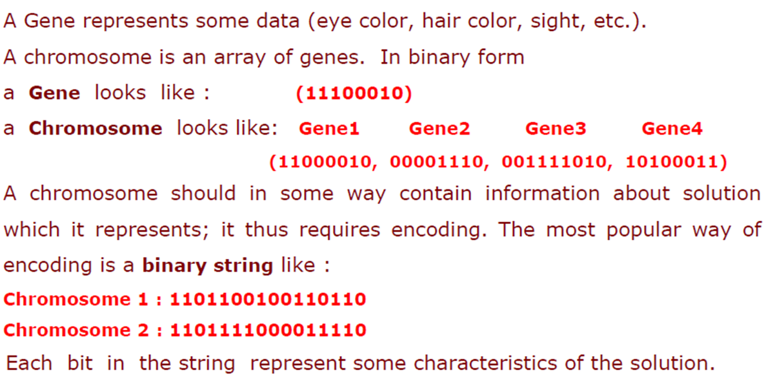
Example: Binary Encoding

Slide 15
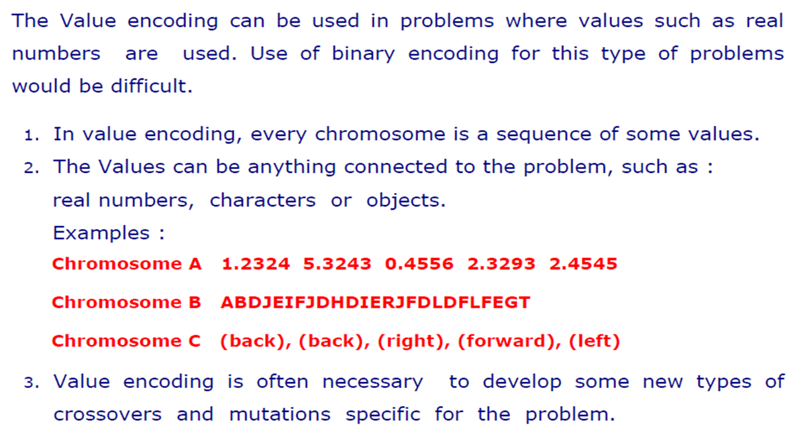
Value Encoding

Slide 16
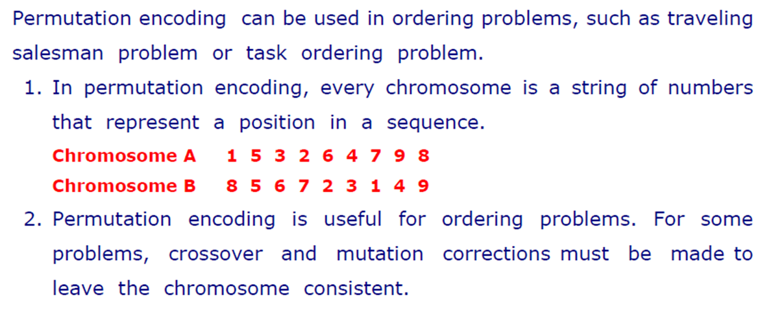
Permutation Encoding

Slide 17
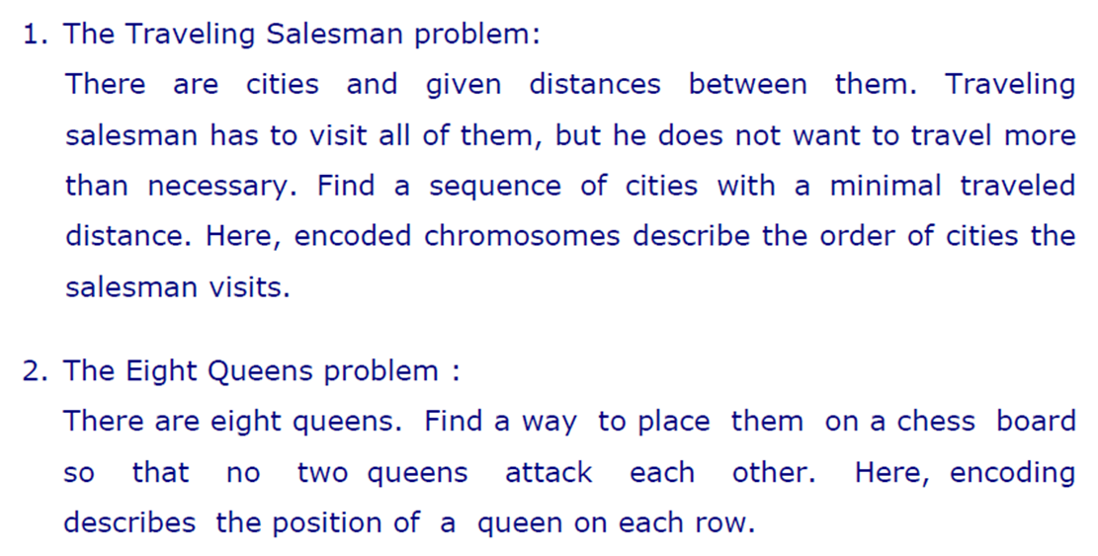
Examples: Permutation Encoding

Slide 18
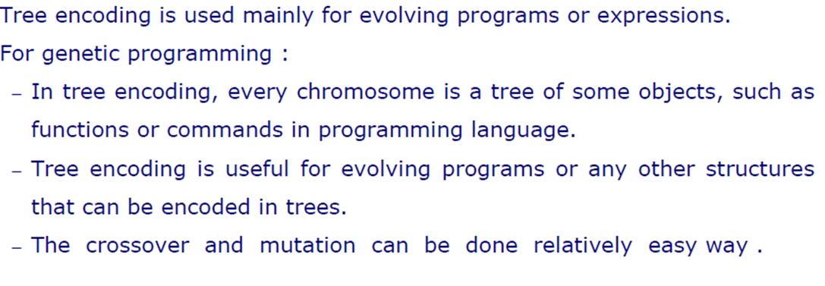
Tree Encoding

Slide 19
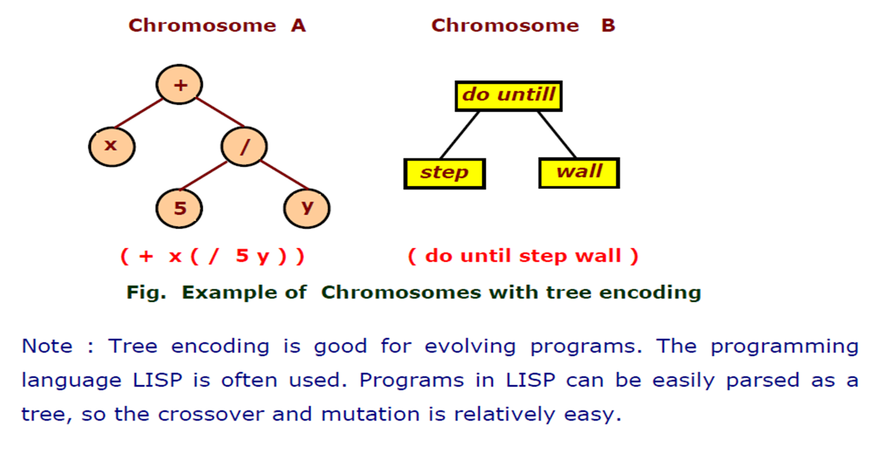
Example : Tree Encoding

Slide 20
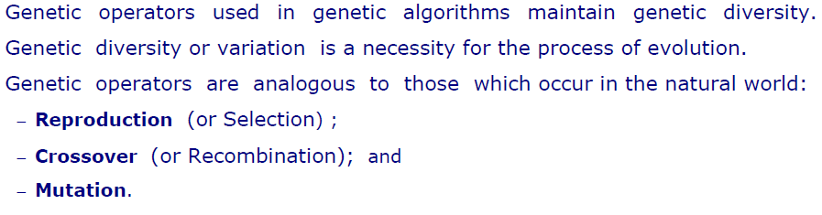
Operators of GA

Slide 21
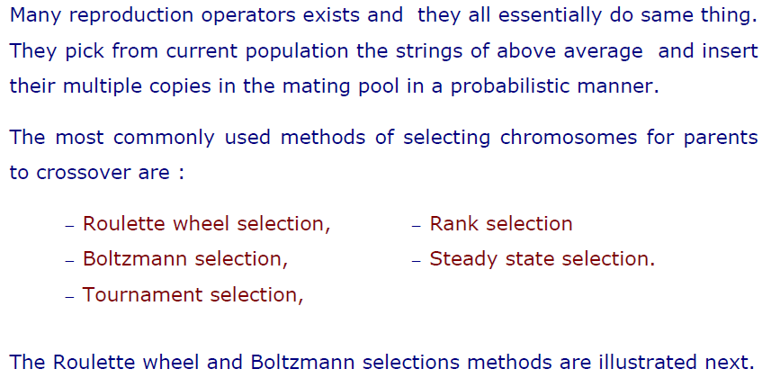
Selection

Slide 22
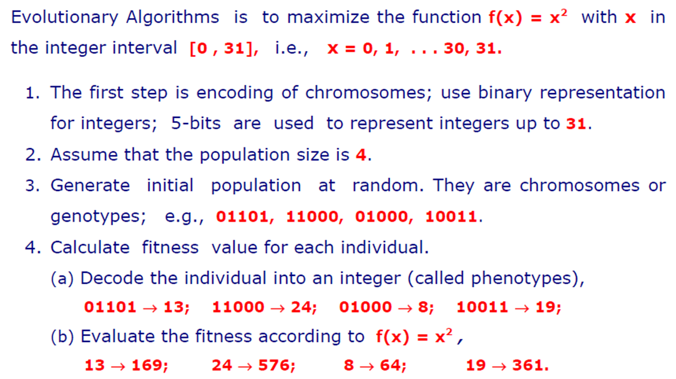
Example of Selection

Slide 23
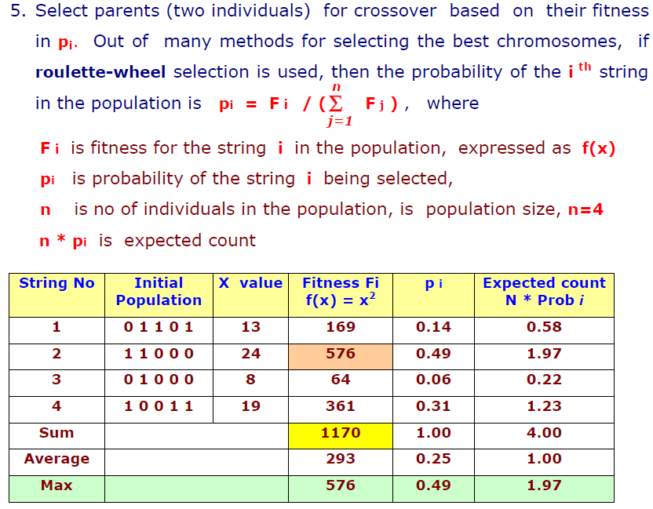
Example of Selection

Slide 24
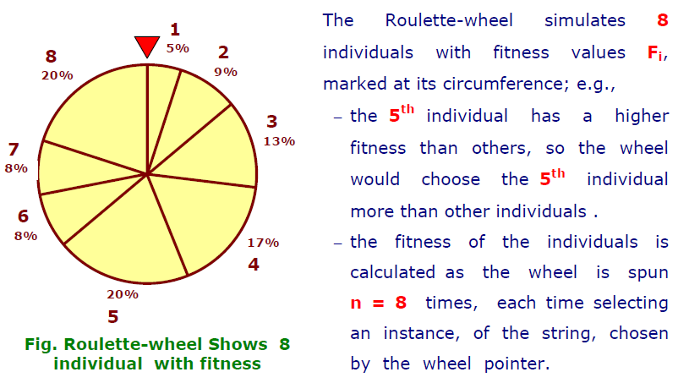
Roulette Wheel Selection

Slide 25
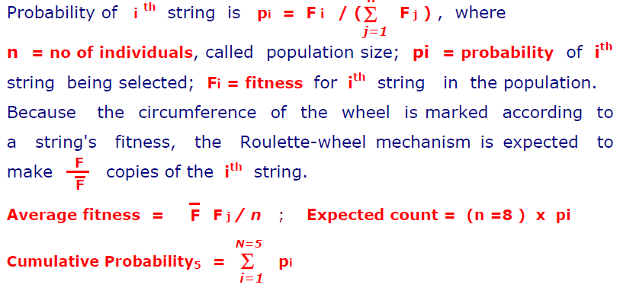
Roulette Wheel Selection

Slide 26
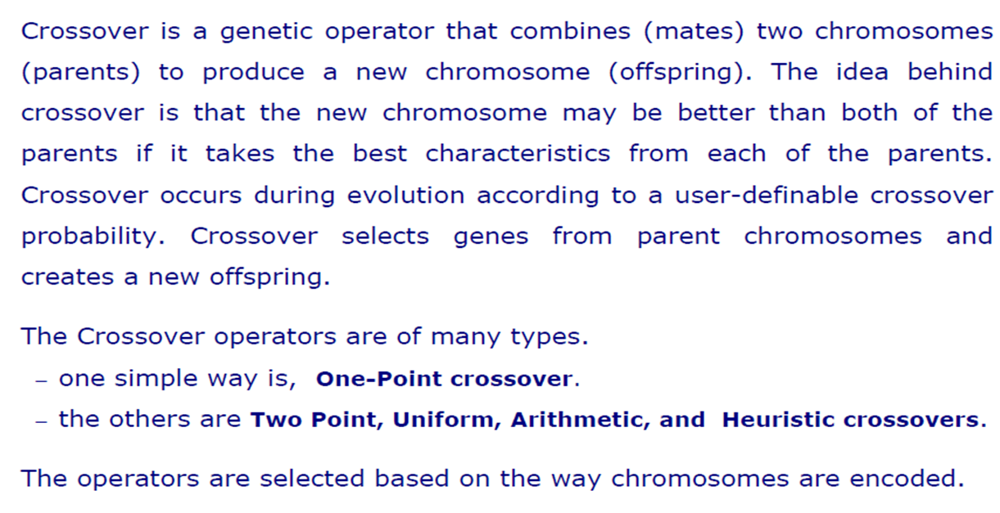
Crossover

Slide 27
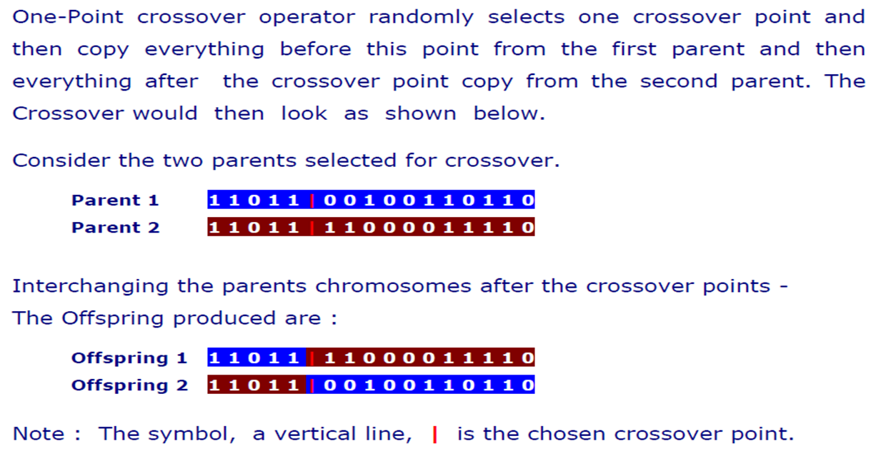
One-Point Crossover

Slide 28
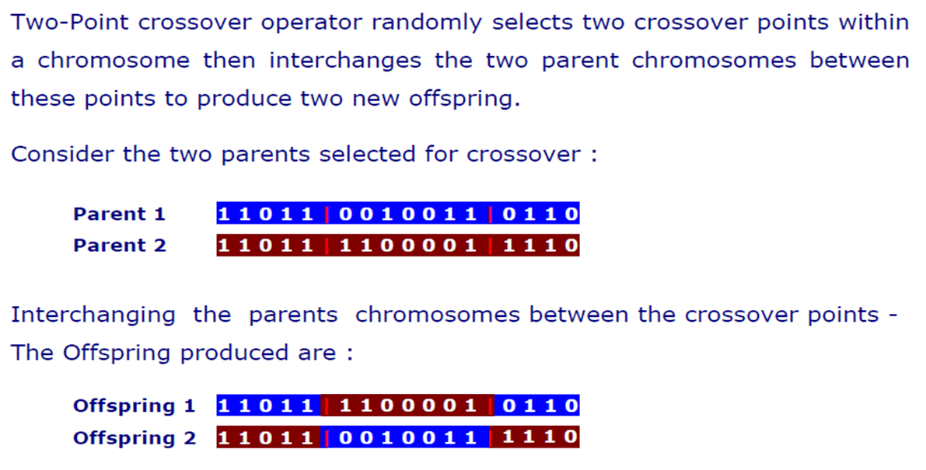
Two-Point Crossover

Slide 29
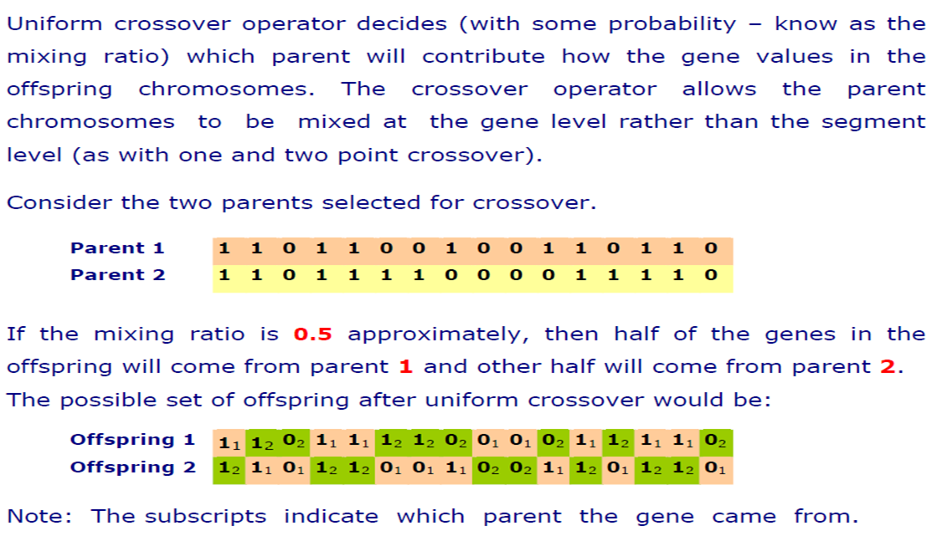
Uniform Crossover

Slide 30
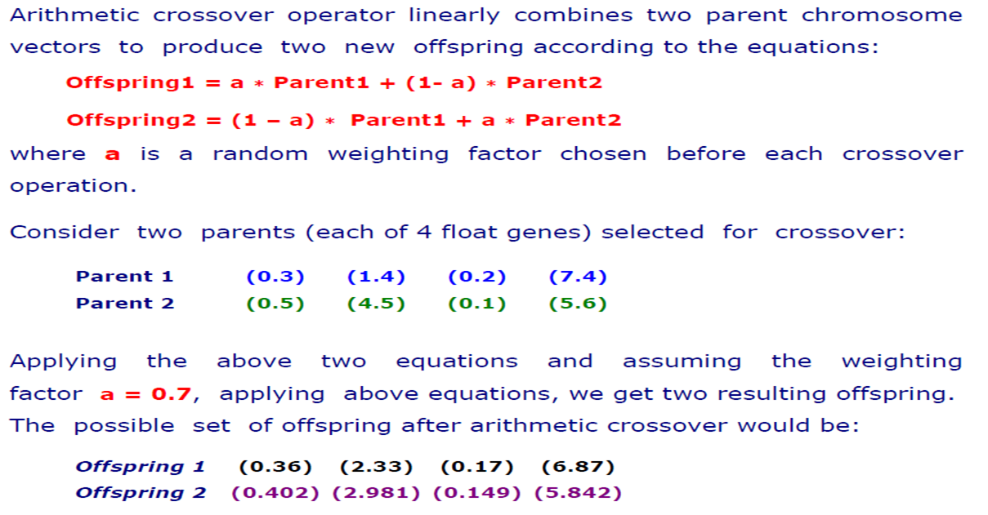
Arithmetic Crossover

Slide 31
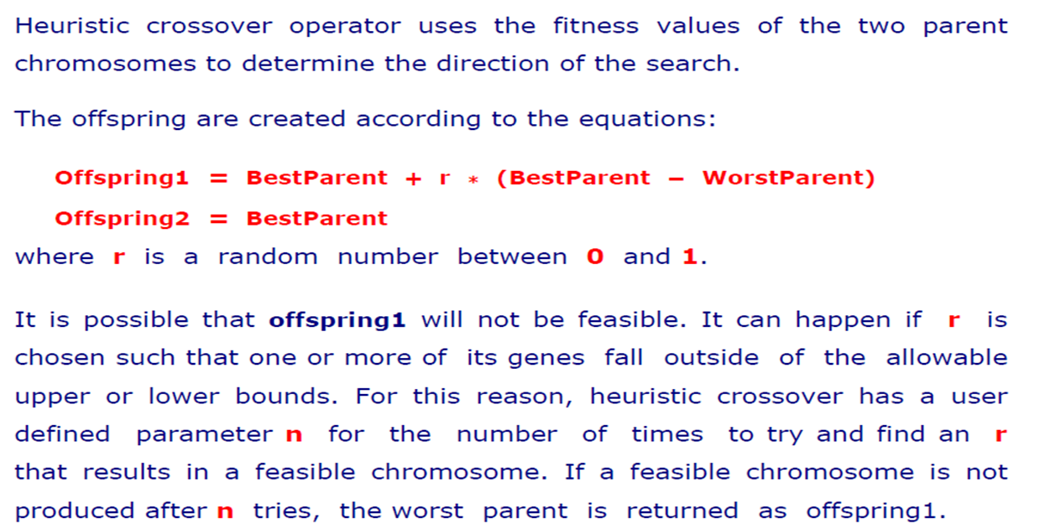
Heuristic Crossover

Slide 32
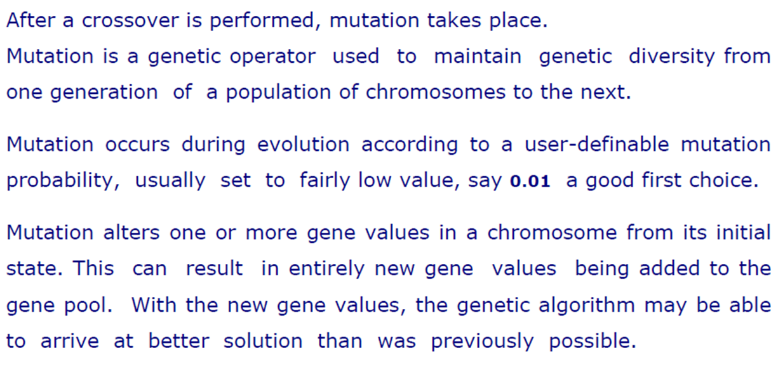
Mutation

Slide 33
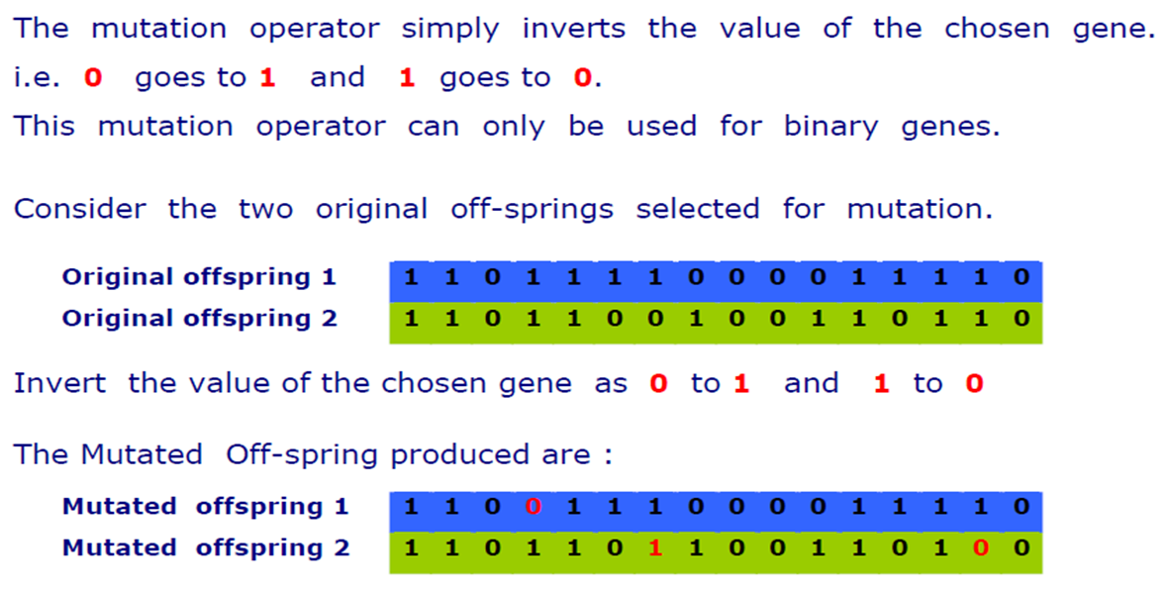
Flip Bit Mutation

Slide 34
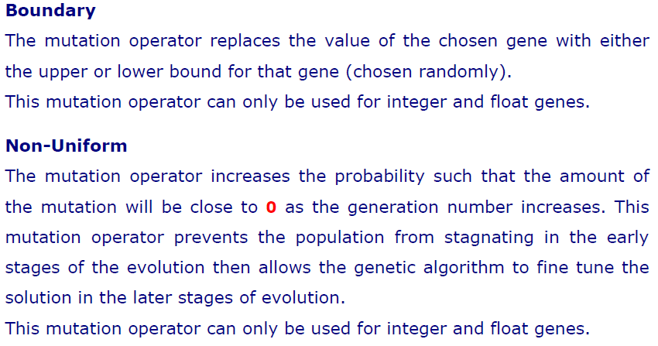
Boundary & Non-Uniform

Slide 35
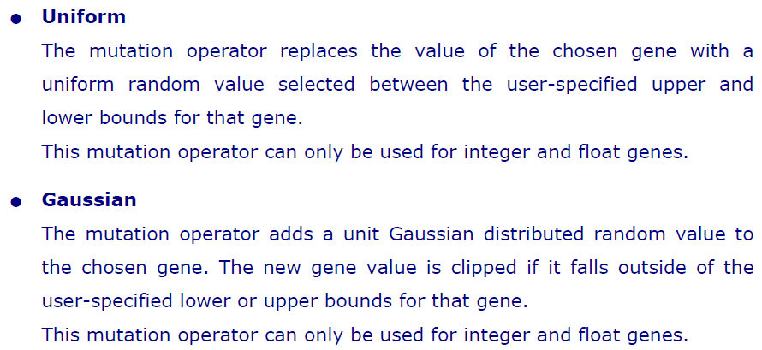
Uniform & Gaussian

Slide 36
Quiz Two
Informed & Uninformed Search

Slide 37
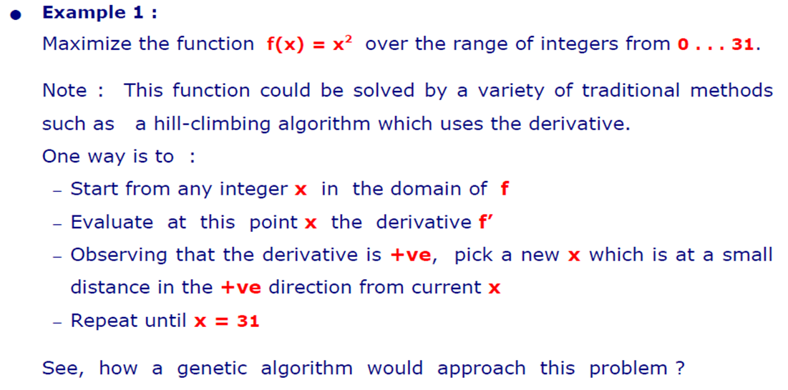
Demonstration

Slide 38
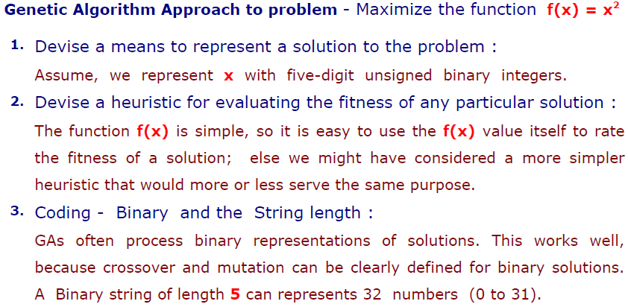
GA Approach

Slide 39
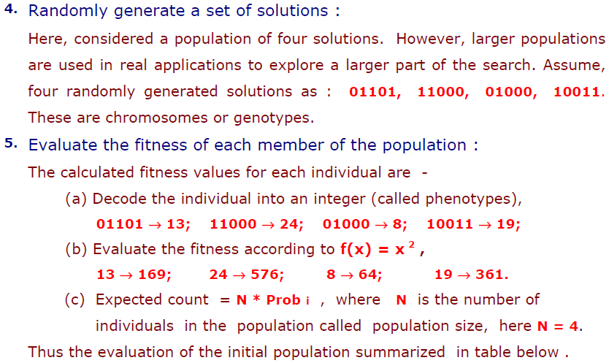
GA Approach

Slide 40
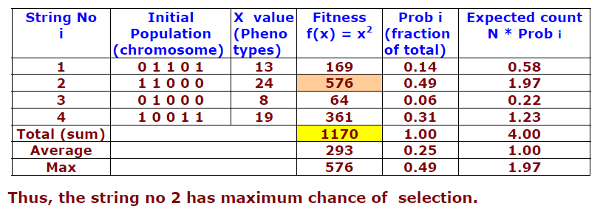
Calculating Fitness & Probability

Slide 41
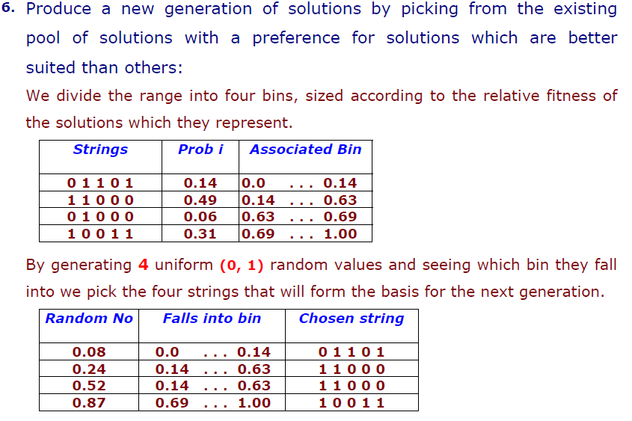
Selection

Slide 42
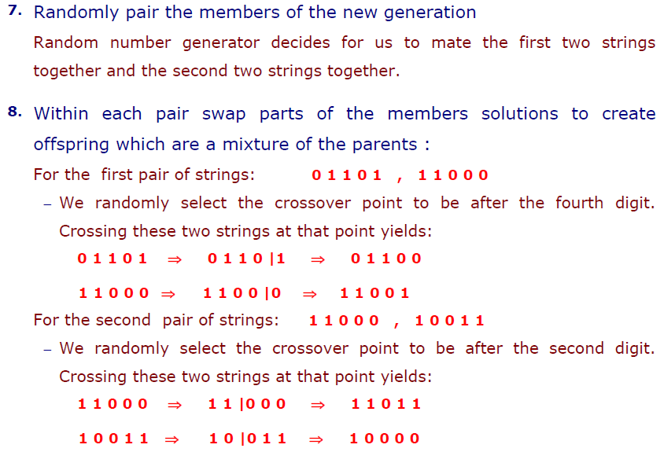
Crossover

Slide 43
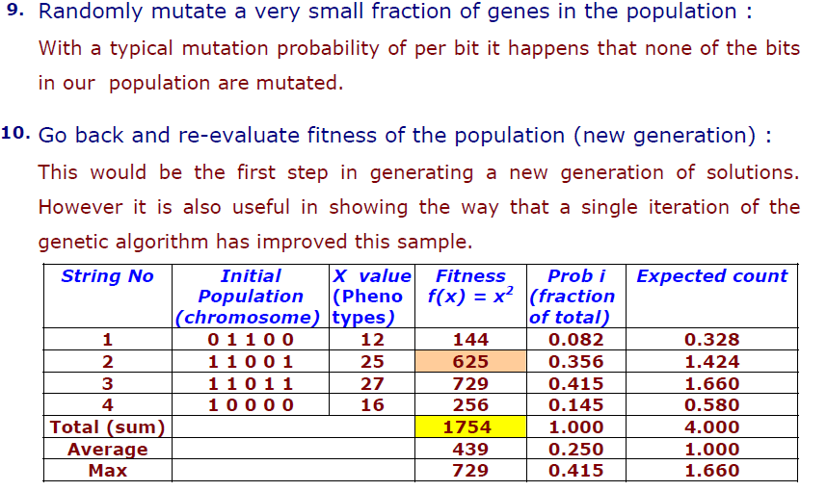
Mutate & Re-evaluate

Slide 44
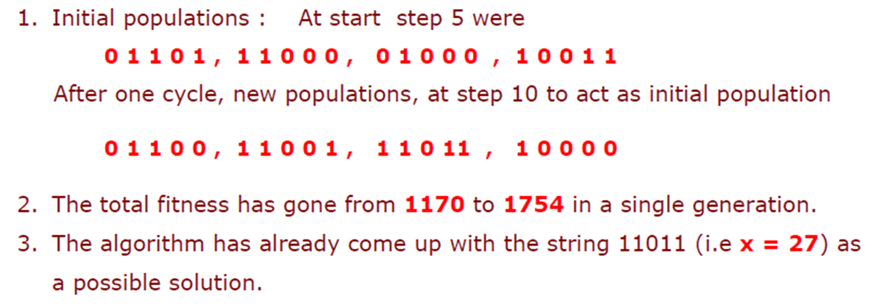
Improved: Individual & Total Fitness

Slide 45
References
“Practical Genetic Algorithms,” by Randy L. Haupt and Sue Ellen Haupt.

Slide 46
Books
“Artificial Intelligence: A Modern Approach,” by Stuart J. Russell and Peter Norvig.
"Artificial Intelligence: Structures and Strategies for Complex Problem Solving", by George F. Luger, (2002)
"Artificial Intelligence: Theory and Practice", by Thomas Dean.
"AI: A New Synthesis", by Nils J. Nilsson.
“Programming for machine learning,” by J. Ross Quinlan,
“Neural Computing Theory and Practice,” by Philip D. Wasserman, .
“Neural Network Design,” by Martin T. Hagan, Howard B. Demuth, Mark H. Beale, .
“Practical Genetic Algorithms,” by Randy L. Haupt and Sue Ellen Haupt.
“Genetic Algorithms in Search, optimization and Machine learning,” by David E. Goldberg.
"Computational Intelligence: A Logical Approach", by David Poole, Alan Mackworth, and Randy Goebel.
“Introduction to Turbo Prolog”, by Carl Townsend.

